Slide 1
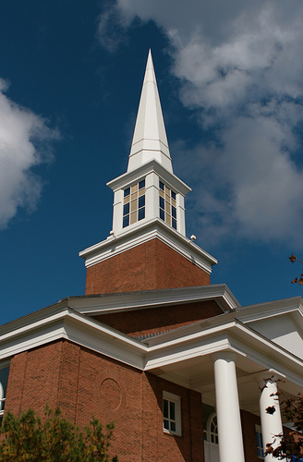
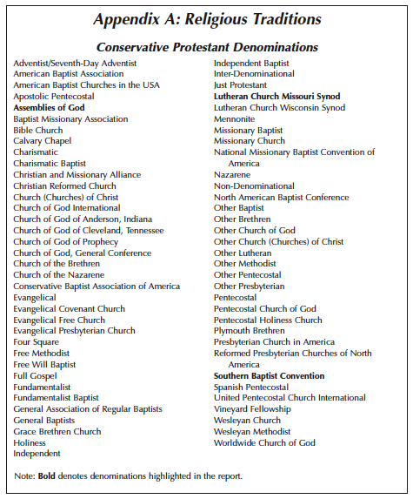
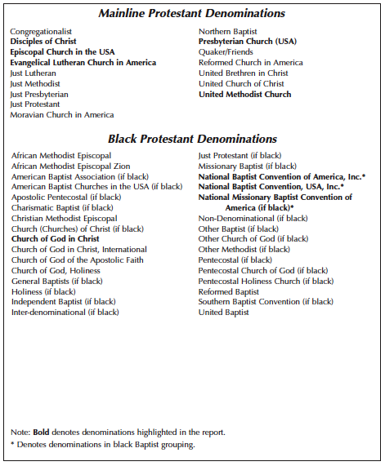
Do Christian College Undergraduates and Alumni Maintain Their Faith? Moralistic Therapeutic Deism and Denominational Commitment
Kaye Cook, Laurieann Smith, Lauren Stone, Matt Van Hamersveld, Austin Mueller, and Rebecca Ross
NEPA, 29 October 2011, Fairfield CT
Smith’s (Schwadel & Smith 2005) Denominational Categories
Abstract
Hypotheses
Procedure
Among Christian college alumni and undergraduates, we evaluated whether emerging adults shift away from institutional toward individualized religion (Arnett & Jensen, 2002). Our participants maintained their denominational commitment as long as four years after graduation (97%). Further, we found few instances of Moralistic Therapeutic Deism (MTD; a parasitic, watered-down religion, Smith 2005, 2009). Instead, we found greater concern for classic religious faith (measured by thematic coding of references to trusting God, owning one’s own faith, and historically central religious ideas). We suggest that global statements about emerging adult religiosity are inappropriate and should be more individualized and nuanced.
1. Alumni will leave church or move into more liberal denominations in college (Arnett & Jensen, 2002).
2. Undergraduates and alumni will move toward individualized religion and Moralistic Therapeutic Deism, a move which will increase with time out of college (Smith, 2005, 2009).
3. Men and Women will express different levels of Moralistic Therapeutic Deism and spiritual commitment.
An email containing a link to our survey on Survey Monkey™ was sent to Gordon freshmen and seniors and to 2006, 2008, and 2010 Gordon and Wheaton alumni.
One-on-one phone or face-to-face follow-up interviews, lasting approximately 30 minutes, were then conducted.
At the beginning of every interview, informed consent was obtained and no names were used during the interviews. Interviews were audio recorded and then transcribed.
Responses to the following two questions were explored by open coding:
When you matriculated at college/currently, what denomination were/are you most connected to? (alumni only)
Since coming to college, how has your faith changed? Give three turning points/markers. (alumni and undergraduates)
Hypotheses 2 and 3
Participants
Again, our hypotheses that participants will move toward MTD and that there will be gender differences in these statements was not supported. These students maintain an orthodox faith.
Undergraduates and alumni (Figure 2) did show some MTD but there were no significant differences in years since graduation or between men and women (Fig. 3). Participants more often used classic descriptors of faith—i.e., referred to ownership of their faith and trust in God—than MTD.
60 undergraduates from Gordon College were interviewed (30 males and females; 30 freshmen and 30 seniors; Mean age, 20.4 years; Range 18-23).
The majority of the sample were Caucasian (84%) and highly religious (72% declared religion was “very important” to them)
240 alumni from Gordon and Wheaton College were interviewed (120 males and 120 females; 100 recent, 100 2-year, and 40 4-year alumni; Mean age, 26 years; Range 22-29).
Sample was largely Caucasian (94%) and even more highly religious (80%)
Moralistic Therapeutic Deism
Smith (2005, p. 162) says a parasitic, watered-down faith has emerged which views God as “something like a Divine Butler and Cosmit Therapist: he’s always on call, takes care of any problems, professionally helps people feel better about themselves, and does not become too involved in the process.”
The three aspects of MTD described by Smith (2005, 2009) are:
Moralistic (God as a source of moral rules): God wants people to be good, nice, and fair to each other, as taught in the Bible and by most world religions. Good people go to heaven when they die.
Therapeutic (God as a problem-solver): The central goal of life is to be happy and feel good about oneself.
Deist (God as distant): A God exists who created and orders the world and watches over human life on Earth. God does not need to be particularly involved in one’s life except when necessary to resolve a problem.
Hypothesis 1
Hypothesis 1 that alumni will move away from faith was not supported. Students are highly religious and remain so. There was no significant difference in years since graduation (figure 1). 40% of participants stayed with their same denomination and 84% stayed within the same denominational category.
Figure 2: MTD Differences Between Undergraduates and Alumni
Differences Between Undergraduates and Alumni
Figure 1: Number Who Stayed in Same Category and Same Denomination
and Who Switched By Year
Undergraduates were more likely than alumni to give classic descriptors of faith, and alumni made more comments about trusting God and owning their faith (χ² (1) = 5.00, p < .001).
Examples of classic descriptors of faith are comments that include concepts such as:
Honoring God in everyday life
Comments about the Trinity
Obeying the church or obeying God
The grace of God
Figure 3: Gender Differences in MTD and Spiritual Statements (Alumni and Undergraduates Combined)
Emerging Adulthood
Conclusions
Emerging adulthood is a unique stage of transition which takes place between the ages of 18 to 25 and allows individuals to “examine the life possibilities open to them and gradually arrive at more enduring choices in love, work, and worldviews” (Arnett, 2000). Religious beliefs held during childhood and adolescence are often put into question during this stage of life.
Most participants (97%) stayed with their denominations. If they did change their denomination they stayed within the same category of conservative, not moving toward mainstream denominations, or out of the church.
We did not find a shift toward Moralistic Therapeutic Deism, a parasitic and watered down form of religion, contrary to Smith (2005, 2009). Instead, participants were more likely to describe faith in classic terms, and to describe their trust in God and ownership of their own faith.
Although MTD perceptions were not common, among the participants, a therapeutic perception was most common.
Undergraduates expressed more classic statements about faith whereas alumni expressed more statements about ownership of faith and trust in God. There were no differences by gender.
References available on handout
Notes:
Again our hypothesis was not supported. Undergraduates and alumni (figure 2) did show some signs of MTD. There was no significant difference in years since graduation or between men and women. Surprisingly, and positively, participants more often referred to ownership of their faith (a personal responsibility) and trust of God.
“Surprisingly and positively, participants more often used classic descriptors of faith—i.e., referred to ownership of their faith and trust in God—than MTD.

